Slide 1
Deloitte Agile Framework
This framework highlights the core elements of an agile project but is not all inclusive. Additional activities² may be required based on the context, scope and scale of the project.
Iterative & incremental cycle that is repeated to deliver value frequently
Project Planning
Discovery
Sprint Cycle(s)
Release
Operate
Typically, 1-3 weeks¹
Typically, 1-2 months¹
Typically, 2-4 week sprints (shorter is better)
Frequent product increments
Initiate and plan the project
Initiate product backlog and establish foundational architecture & infrastructure
Iteratively develop the product through minimum viable product sets (MVP) in potentially deployable increments, and increase efficiency and quality through frequent feedback and improvement loops
Deploy the solution and provide subsequent support
Embody the agile mindset
Establish ways of working (Project Management Plan)
Develop schedules
Master Plan
Integrated Work Plan
Onboard and train team
Define and configure project tools
Determine status reporting approach
Establish user experience approach and personas
Define and prioritize EPICS and FEATURES
Establish solution architecture
Develop initial ROADMAP and MVP RELEASE PLAN
Define initial DOR and DOD
Develop prioritized PRODUCT BACKLOG
Decompose priority features to initial (and ready) user stories
Establish planned capacity and velocity
Establish Testing (incl. automation) strategy
Establish Continuous Integration process
On-going Refinement
Perform product backlog Refinement
Refine roadmap & MVP release plan
Conduct release testing including regression, integration and user-acceptance testing
Execute dress rehearsal
Make go/no-go decision
Execute deployment plan
Deliver change management and training
Facilitate production support activities
Execute solution hand-over
Close release
Conduct Sprint Planning
Validate expected velocity and establish capacity
Identify prioritized, ready user stories
Decompose user stories into tasks with estimated hours
Commit to completing a set of user stories
Close sprint
Conduct sprint review
Calculate actual velocity
Conduct sprint retrospective & identify improvements to implement
PRODUCT INCREMENT
Execute Sprint: Deliver Working Software
Develop application components
Perform code review
Conduct unit tests
Produce software build
Produce essential documentation
Validate/test user story
Obtain PO acceptance of user story
Collaborate & Manage
Manage SPRINT BACKLOG
Manage burndown charts
Conduct daily stand-ups
Conduct scrum of scrums
Update roadmap and Kanban board
Resolve IMPEDIMENTS
Prepare for and perform testing
Execute integration & regression testing
Prepare for additional release testing as applicable
¹Varies depending on project complexities
Complete non-sprinted project activities²
The application of DevOps principles, processes & techniques with agile delivery allows working software to be released more frequently
²May include infrastructure, change management, security & controls, data, deployment planning etc.
Notes:
There are various agile methods/ no single/ONE right way/ no one-size-fits-all - but this is Deloitte's agile framework, heavily rooted in scrum, based on our experiences/leading practices
Also influenced by/related to lean and devops principles
This framework highlights the core agile elements - based on scope/scale of project, would have other activities as well/ tailor this

Slide 2
Agile Framework: Execution Detail
Notes: This is a representative view, not to timeline scale and not inclusive of all activities/deliverables (see EVD for the full method content and details)
Discovery project planning = one-time activities; Discovery sprint 0 is meant to be iterative as needed
Phases should overlap as appropriate – e.g. Non-sprinted activities may overlap with Discovery Sprint 0/ come before sprinting can begin
Discovery
Sprint cycles
Release
Test, Deploy, Stabilize, Operate & Optimize/ Innovate
Plan & mobilize engagement, initiate product backlog, and establish foundational architecture and infrastructure
Iteratively and incrementally develop potentially deployable product increments, increasing efficiency and quality through frequent feedback and improvement loops
Deploy minimum viable product (MVP) sets, provide subsequent support, inspect and adapt
Project Planning
Conduct SPRINT PLANNING
Define and refine PROGRAM INCREMENT
Test
Establish ways of working
Develop project management plan and user story management plan
Prepare discovery sessions
Prepare for software development, migration, source code, and integration by developing appropriate strategies, processes, standards (including continuous integration process and unit test approach)
Plan and mobilize project
Develop project charter
Complete deliverables log
Develop master plan
Develop integrated work plan
Plan and conduct kick-off
Acquire project team
Install and configure tools
Train project staff
Deliver user stories
Execute release testing (system integration/ integration, mock conversion, parallel, regression, performance and stress, infrastructure, user-acceptance)
Conduct test
Deliver working software
Configure system
Develop code & review
Produce software build
Conduct unit test
Develop essential documentation & detailed business processes as required
Deliver security and controls
Build and test identity and access management solution
Implement privacy roadmap
Build and test role-based security and security vulnerability
Confirm implementation of business process, general IT, interface and data conversion controls
Perform functional & regression testing
Develop test cases
Identify test data & populate environment
Develop and test automation scripts
Conduct test
Deploy
Establish security and controls approach
Define security architecture
Develop security, privacy, and controls approach
Design & develop project team application security roles
Accelerate future skillsets
Deploy & evaluate learning
Deploy production solution
Deliver data integration and conversion solution
Produce software build
Execute dress rehearsal
Conduct production deployment go/no-go
Execute production deployment
Perform legacy system decommissioning
Sprint 0
User stories accepted by PO as delivered
Define business needs
Perform high-level process design
Plan solution validation*
Stand up baseline solution
Plan and prepare baseline solution
Develop prioritized BACKLOG
Define and prioritize EPICS and FEATURES
Decompose priority features into initial USER STORIES
Accelerate future skillsets
Develop learning curriculum
Develop learning courseware and simulations
Personalize the change campaign
Execute the change campaign
Activate business networks
Engage business advocate networks
Develop and launch super user program
Transfer knowledge to solution owners
Stabilize & Operate
Define DOR and DOD
Define deployment strategy
Develop initial ROADMAP and MVP release plan
Perform hypercare
Perform service desk function
Conduct service delivery transition
Transition service delivery
Implement continuous service improvement program
Conduct service delivery training
Transition solution documentation to support organization
Establish CAPACITY and VELOCITY
Establish foundational technical infrastructure
Define logical infrastructure
Define technical architecture
Refine backlog (PBR) and roadmap
Manage product & SPRINT BACKLOG
(Continue to) Define/Refine user stories
Refine roadmap
Conduct agile ceremonies/events
Conduct DAILY STAND-UP
Perform SCRUM OF SCRUMS
Close sprint
Perform SPRINT REVIEW
Calculate actual velocity
Perform SPRINT RETROSPECTIVE
Establish application and integration architecture
Define test strategy
Maintain and operate infrastructure
Establish user experience design
Define user experience guidelines
Define user personas
Plan test automation
Define test automation approach
Define & develop test automation framework
Non-sprinted activities
Close project
Design data management, cleansing, architecture, governance & plan for data conversion
Deliver data conversion
Develop specifications
Develop code
Conduct technical unit and functional object tests
Prepare for release testing (system integration/ integration, mock conversion, parallel, regression, performance and stress, infrastructure)
Develop test approaches, cases & plan
Identify test data
Manage integrated work plan
Establish security and controls design
Develop identity & access management solution design
Develop privacy roadmap, requirements and control activity framework
Develop general IT, interface and data conversion control framework
Define segregation of duties and sensitive access
Mobilize and engage communities
Develop organizational change management strategy
Design change campaign
Develop business advocate network (BAN) approach
Track value realization
Prepare for production deployment
Define release go/no-go criteria
Develop deployment plan
Define batch jobs
Develop batch job schedule
Plan hyper care
Develop to-be service delivery approach
Develop service delivery transition plan
Plan service delivery
Perform service delivery framework assessment
Develop to-be service delivery approach
Document service delivery requirements
Develop service delivery recommendations & resource estimate
*Optional for projects using transfer solution or pre-configured solution
Key tips
Key tips
Key tips
Allocate appropriate time for core planning activities and discovery at the beginning of the project
Involve an agile coach from the start
Establish appropriate governance and controls - and balance that with the agile/ lean mindset
Invest adequate time and effort in aligning across Deloitte and client project team on roles, responsibilities, delivery approach, scope, ceremonies, etc.
Train agile team on agile mindset and discovery process
Define your epic/feature structure early so there is consistency and so project reporting needs are met
Understand forecasted scope vs capacity and timeline at high-level from the start to understand how much capacity you can dedicate to adjusting, iterating and making changes to the solution based on feedback
Complete foundational elements such as establishing user experience design and technical infrastructure early to inform user stories
Do just enough foundational solution design to support writing user stories with accuracy
Invest energy developing solid user stories (and training the team to do so)
Have enough ‘ready’ user stories (and foundational design) to get started (at least 3 sprints’ worth), but not so much that you box yourself in/ struggle to flexible or require significant re-work
Define a process for developing “ready” user stories
Product owner collaborates with Deloitte and client development team members to develop user stories, including required supporting documentation to make the “what” clear
Development team reviews, confirms understanding and estimates user stories
Product owner approves user stories
In the roadmap, don’t put off all the big or complex user stories until the end
When prioritizing the product backlog, manage against the contracted scope (as relevant), have open conversations about tradeoffs, and manage delivery dates
MVP requires a “critical mass” of components that have to be deployed in an initial release to provide a usable solution; additional advanced features or capabilities can be added later to enhance the product
The engagement work determined to be delivered in a traditional way, needs to be planned for, capacity allocated and managed in an integrated work plan or within the agile management tool as pseudo user stories
Only sprint user stories that are ready (the team, using the DoR, decides which user stories are ready)
Consider capacity when planning (ideal hours) the sprint backlog and managing the roadmap; dedicate enough capacity (outside of the sprint) for PBR and any other non-sprinted activities (e.g. test prep)
Let development teams work independently as they sprint – no changes mid-sprint
Design related documentation (e.g. specs) should be lean and focus on what’s essential/ required
Adopt Test-Driven or Behavior-Driven development approaches to shift testing left
Keep sprint durations as short as possible (2-4 weeks)
Consider using a practice sprint to determine mechanics of a sprint; delivering functionality is optional
It takes a few sprints to get to working velocity; use them to get into a cadence and don’t be too aggressive when planning initial sprints
Include geographically distributed team members in ceremonies to enhance collaboration
Mutually manage scope priorities with the client to understand the change impacts and tradeoffs (adding/removing user stories from roadmap as needed)
Regularly perform PBR - always have at least 2-3 sprints worth of ready user stories
Prepare testing execution before the testing phase begins – start early and allocate capacity to these preparation activities
Prepare for deployment early
Remember to infuse DevOps leading practices, such as –
All check-ins should be traceable to an user story or a defect
All developments and unit testing should be done locally
Consider multiple small-sized code commits (at least once a day)
Developers should collaborate on code in a single branch (called ‘trunk’) instead of creating other long-lived branches, , thereby avoiding merge and build issues
All the application code, configuration and static content (e.g., CSS, HTML) should be in the source control system
It is important to verify that the application runs as expected in a production-like environment before deploying it to production; this requirement should be added to the definition of “done” for the development.
Teams should release MVP sets as early and often as possible
Practicing continuous delivery (CD) requires automation and management of the build, packaging, and deployment scripts, which can be addressed through version control check-ins
Trunk-based development is a key enabler of continuous integration (CI) and, by extension, continuous delivery (CD)
Any build should be deployable to any of the environments by ensuring that the source code has no environment-specific configurations
The success of agile delivery relies on the ability to maintain the codebase in a deployable state at all times. Hence, the unit test suite should be run as part of the build process
Services as a deployable unit should be mutually exclusive; independently deployable, testable, and scalable; and isolated from failures of other upstream or downstream application/services
To achieve the DevOps outcomes, shift reliance to control mechanisms (like automated testing, automated deployment and peer review of code changes) to drive transparency, responsibility, and accountability between developers and operations
Ensure monitoring alerts i.e. server monitoring and application performance monitoring are in place

Slide 3


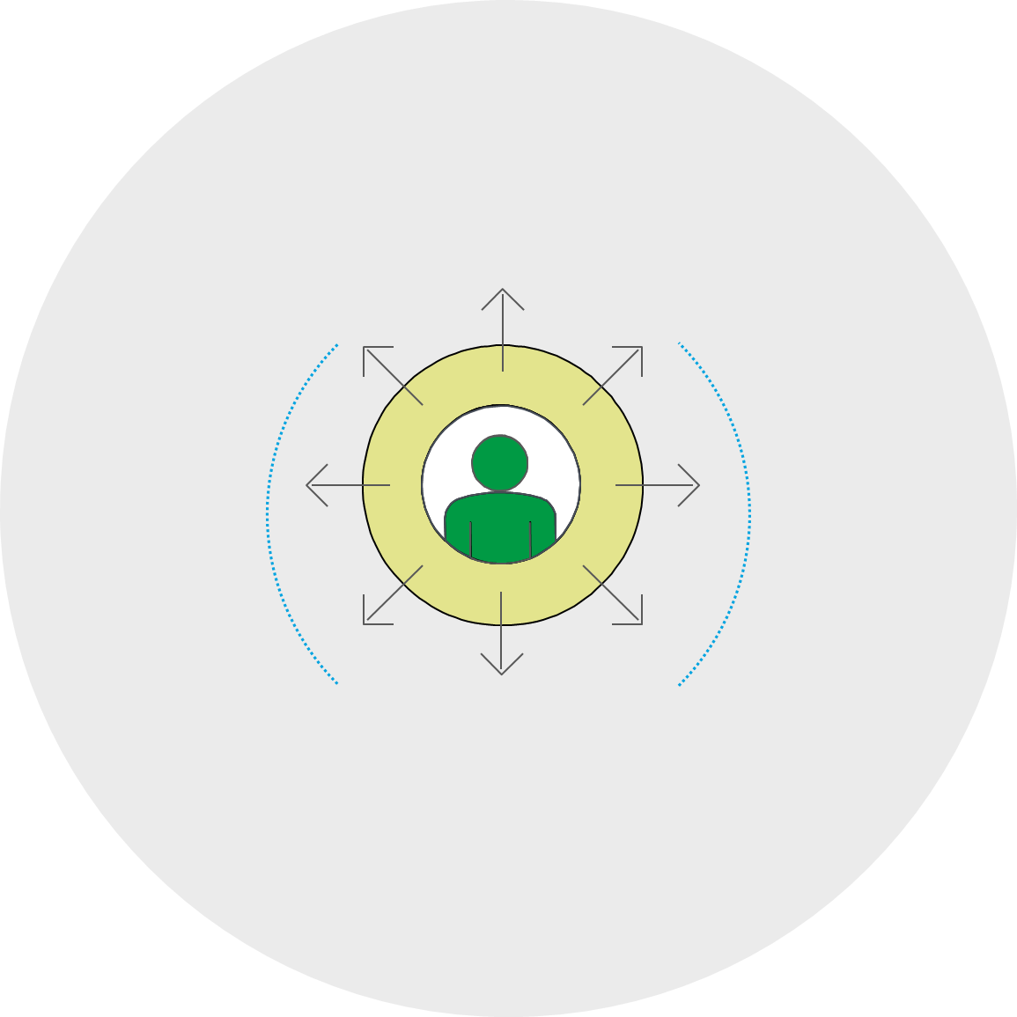
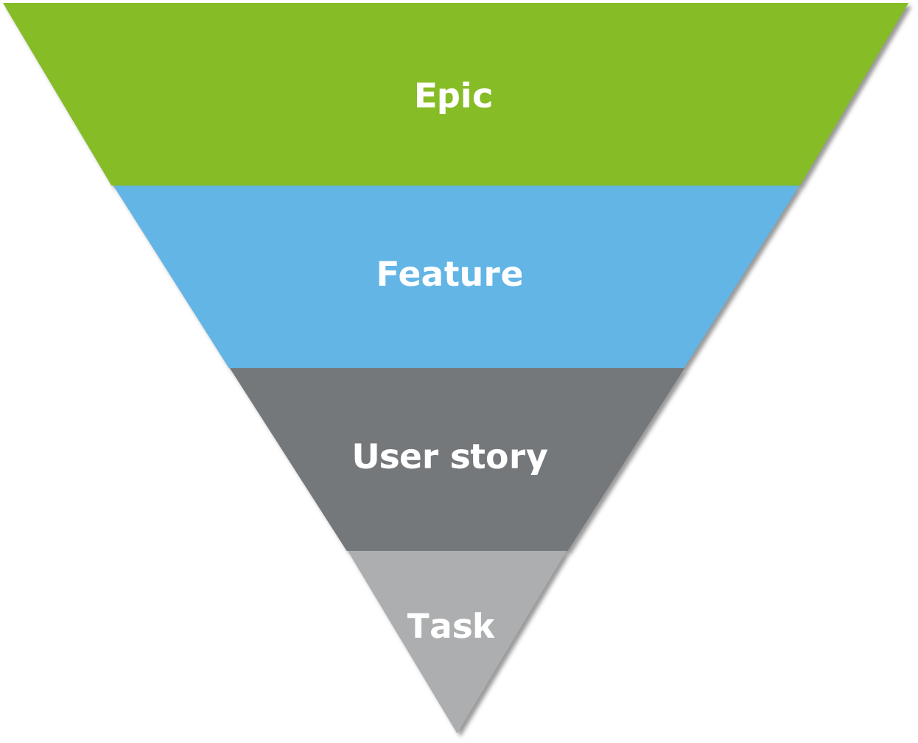

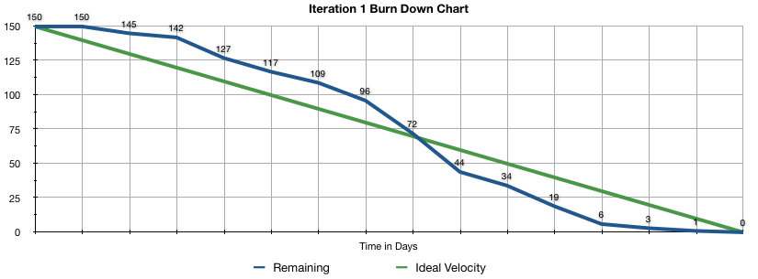


Agile Quick Reference Guide
Development team
Cross-functional (with all skills necessary to create a product increment), self-organizing and self-managing team, about 3-7 members
Individual team members may have specialized skills/areas of focus, but accountability belongs to the team as a whole
Committed to the work full time, not splitting their time over numerous projects or teams
Perform the tasks of delivering the product increment
Team maintains the sprint backlog, defines tasks and assignments
Participates in product backlog refinement (PBR) to help update, groom, and estimate user stories for future sprints
Product owner (PO)
Voice of the customer: regularly and consistently engages with business stakeholders and is accountable for product success
One person per scrum team – not a committee
Must be experienced, empowered, influential, committed, and trained
Accountable for the product backlog, priorities, and defines all product features
Ensures team is working on highest value features
Negotiates work with the team by discussing the priorities along with the team’s capacity and velocity
Scrum master (SM)
A servant leader who enables close cooperation across all roles and functions
Ensures that the team is fully functional and productive
Shields and protects the team from external interferences
Manages, removes, and escalates (as needed) impediments identified by the team
Sprint
A time-boxed iteration of one month or less during which scrum team(s) work to complete a set amount of work to create a "Done", useable, and potentially releasable product increment
Sprints include sprint planning, daily stand-ups, development work and testing, sprint review, and sprint retrospective
Sprint planning
Collaborative team working session to plan sprint; answers what can be delivered and how the work will get done
Conducted on day 1 of each sprint, typically 2-4 hours for a 2-week sprint (scaled depending on sprint duration)
Entire scrum team participates; SM acts as facilitator
Velocity for sprint set based on confirming team capacity and reviewing historical velocity
Sprint goals are defined and team selects user stories from product backlog for the sprint backlog based on priority (only “Ready” stories that meet DoR are considered) until team’s velocity is met
PO provides clarification on selected user stories
Selected user stories are broken into tasks and development team estimates effort to complete tasks (in hours), considering DoD
Development team commits that all stories can be completed as part of the sprint
Scrum team roles
Daily stand-up
A daily 15-minute ceremony for the development team to optimize team collaboration and performance, focusing on progress toward the sprint goal (SM also attends, PO optional)
Held every day (except for the first and last days of sprint) at the same time and place
Development team members share progress with team (not to SM or PO), answering:
What did I do in the last 24 hours?
What will I do in the next 24 hours?
Any impediments/blockers in my work?
Team often meets immediately after for detailed discussions regarding impediments (with PO)
Sprint review
Held at the end of the sprint to share the outcomes of the sprint, elicit feedback, and foster collaboration
Attended by entire scrum team, business owners, and stakeholders (often managers/execs)
Typically 1-2 hours (no longer than 4 hours)
Agile team demos “Done” user stories previously approved by PO (it is not an acceptance meeting)
Feedback is gathered and owned by the PO to incorporate into product backlog
Product backlog refinement (PBR)
The act of adding detail, estimates, and order to items in the product backlog
An on-going activity to ensure the product backlog is always being refined ahead of the teams who will pull work from it
SMEs may spend a significant amount of time working on developing features and user stories → allocate appropriate capacity for PBR
Before sprint planning, the entire team should have previewed and estimated user stories
Schedule PBR sessions regularly with sufficient time to maintain backlog of 3 sprints worth of ready user stories (1-2 per week for 2 hours)
Ceremonies & events
Product backlog
A dynamic list, in priority sequence, of features and user stories to be developed
Continually refined to contain at least 3 sprints’ worth of ready user stories
Prioritized and maintained by the PO
Sprint backlog
A group of prioritized and estimated user stories decomposed into tasks that the development team commits to complete during the sprint
It is created by the development team (based on direction of priorities set by the PO and sprint goals) during sprint planning and maintained by the development team during the sprint using story and task boards
Sprint retrospective
A closed team ceremony to identify continuous improvement opportunities to be implemented in the next sprint
Typically 1 hour
Held after the sprint review and prior to the next sprint planning
Questions:
What did we do well?
What did not go well?
What can be improved?
User stories
Descriptions of desired functionality, told from the perspective of the user
Should not take more than half a sprint to meet the definition of done (DoD)
Each story is captured as a separate item on the product backlog
A user story includes a title, description (user story statement), acceptance criteria, and supporting documentation (e.g. wireframes, high-level design)
User story statement:
As a…persona (who)
I want to…achieve a goal (what)
So that…tangible benefits that will be realized (why)
Acceptance criteria explains the PO’s conditions of satisfaction that the story must meet to be accepted as complete; the minimum functionality for a given story; allows the scrum team to gain a shared understanding of the complete story
Scrum of scrums
A technique to scale scrum up to large groups where representatives from clusters of scrum teams discuss cross-team integrations, dependencies, impediments
Also used for process reminders/changes to ensure hygiene or make improvements
Attended by SMs, POs, select development team members
Plan for 2-3 scrum of scrums per week
Relative estimation
Estimate features using t-shirt sizing, user stories in story points, and tasks in hours
T-shirt sizing (XS, S, M, L, XL) is an effective way of removing the element of time from the level of effort
Story point estimating is done during PBR as the user story is further detailed. Story points represent the relative measure of the size or complexity of a story, based on a modified Fibonacci sequence; collaborative estimation techniques like planning poker drive discussion and consensus on the work that needs to be done
Task estimation in hours is done during sprint planning by the team committing to delivering it and is based upon the actual effort each task is expected to consume
Develop estimation guidelines for scrum teams so that estimates are generally consistent from one team to the next
Persona
A generalized character that represents a set of user types that will be using the solution in a similar way
Represents how the specific persona interacts with the system so that the solution features meet user needs and expectations
Artifacts
Product roadmap
Forecast of planned releases including epics, features, and user stories
Medium to long-term planning is reflected in the roadmap and the product backlog
Forecast is continually adjusted as priorities change and as sprints are completed
Product increment
The sum of the user stories completed during a sprint
The new product increment can be implemented by itself or packaged together with increments from previous sprints
Complexity
Definition of ready (DoR)
Documents criteria any user story has to reach before the team can plan it in a sprint
Applies to all user stories
Ensures that the incoming work meets a basic level of quality, which will help prevent confusion and wasted time that the team might spend on trying to understand the requirements once the work begins
Needs to be defined and understood for discovery and ongoing PBR
Definition of done (DoD)
A quality checklist of activities that must be completed in order for any user story to be considered complete
Applies to all user stories
Improve and expand the DoD over time to ensure quality
Burndown chart
Used to track and forecast progress
Graphical representation of estimated work remaining in a sprint over time
Calculated in story points or hours
When calculated in story points, no partial credit – story points recognized only when stories are complete and meet DoD
Generated by tool and monitored daily
Team capacity
Total number of hours each team member is available to work on backlog items during the upcoming sprint
Initially calculated during discovery and revisited in sprint planning
Considers holidays, PTO, training, conferences, etc.
Capacity = total FTE days in the sprint x ideal hours
Ideal hours guideline is ~6 hours/day to allow time for meetings, overhead, non-sprint work
Team velocity
The estimated total number of story points an scrum team can be expected to complete in a sprint
Calculated as the rolling average of the velocity from the previous 3 sprints
Used to plan for sprint
Velocity should not be compared across teams
Story & task boards
Used to visualize and manage the work
Includes all the user stories and tasks for the sprint
Each item’s progress is tracked by the team during sprint execution
Impediments can be tagged against the board
Can be physical and/or accessed in tool
Other terms & techniques
Story mapping
A visual representation of a product backlog to make end-to-end product scope visible
An arrangement of user stories in a two-dimensional map resulting in a sequential narrative from left to right and priorities from left to right
Minimum viable product (MVP)
The smallest subset of features that can be implemented together to deliver value to the business
Scope is sliced horizontally across the story map to deliver value
Impediment list
Items preventing team from completing work
Maintained by SM
Impediments can be removed upon resolution or during the daily standup by the team
SM accountable for removing all impediments and escalating as appropriate
User Stories
To Do
In Progress
Done

Slide 4
Agile Quick Reference Guide
Manifesto for agile software development
Agile guiding principles
The agile manifesto states: We are uncovering better ways of developing software by doing it and helping others do it. Through this work we have come to value:
Satisfy the customer | Our highest priority is to satisfy the customer through early and continuous delivery of valuable software. | Working software is primary | Working software is the primary measure of progress.
Welcome Change | Welcome changing requirements, even late in development. Agile processes harness change for the customer's competitive advantage. | Maintain a constant pace | Agile processes promote sustainable development. The sponsors, developers, and users should be able to maintain a constant pace indefinitely.
Deliver frequently | Deliver working software frequently, from a couple of weeks to a couple of months, with a preference to the shorter timescale. | Focus on technical excellence | Continuous attention to technical excellence and good design enhances agility.
Work with business people | Business people and developers must work together daily throughout the project. | Keep it simple | Simplicity--the art of maximizing the amount of work not done--is essential.
Support motivated people | Build projects around motivated individuals. Give them the environment and support they need, and trust them to get the job done. | Teams should self-organize | The best architectures, requirements, and designs emerge from self-organizing teams.
Use face-to-face conversation | The most efficient and effective method of conveying information to and within a development team is face-to-face conversation. | Reflect and adjust | At regular intervals, the team reflects on how to become more effective, then tunes and adjusts its behavior accordingly.
Individuals and interactions
over
Process and tools
Working software
over
Comprehensive documentation
Customer collaboration
over
Contract negotiation
Responding to change
over
Following a plan
While there is value in the items on the right,
we value the items on the left more. – agilemanifesto.org
Decomposing business requirements
Iterative
Incremental
An iterative process is one that makes progress through successive refinement. The first iteration of a product may be incomplete or weak in some areas. The team then iteratively refines those areas until the product is satisfactory. With each iteration, the product is improved through the addition of greater detail.
An incremental process is one in which a product is built and delivered in pieces. Each piece, or increment, represents a complete subset of functionality. The increment may be either small or large. New increments are created until the product is complete
An epic is a large body of work that can be broken down into a number of related groups of functionality
Allow the customer to manage its own account via the web (might by IP5 “Process” (L2) on ERP projects)
Epic
Feature represent a distinct element of functionality which can provide capabilities to the business
Feature
As a customer I want to change my account information via the web portal (might be IP5 “Sub-process” (L3) on ERP projects)
Scrum and agile are both incremental and iterative. They are iterative in that they plan for the work of one iteration to be improved upon in subsequent iterations. They are incremental because completed work is delivered throughout the project.
User stories are descriptions of desired functionality, told from the perspective of the user
As a customer, I want to be able to modify my ship-to address so that new orders are delivered correctly.
Mountaingoatsoftware.com
User story
Empirical behaviors
Tasks are further decomposition of user stories which are activities that are required in order to help a user story meet the definition of done.
Task
(1) Configure solution
(2) Conduct unit test of configuration changes
(3) Conduct peer review…..(etc.)
em·pir·i·cal
/əmˈpirik(ə)l/
based on, concerned with, or verifiable by observation or experience rather than theory or pure logic.
Decisions are made based on observation and experimentation rather than on detailed upfront planning. Empirical process control relies on the three main ideas of transparency, inspection, and adaptation.
Epics and features are simply ways of grouping user stories into a hierarchy so that they can be discussed simply – don’t get hung-up on rigid definitions.
Scrumstudy.com

